Slide 1
A Practical Starter Guide to SQL Notebooks
Deborah Melkin (she\her)
March 17, 2023

Slide 2

I really want to learn how to use SQL Notebooks but I don’t have time to figure it out at work either.
So let’s go on a quest to do this stuff together.

Slide 3


Who Am I?
20+ years as a DBA
NESQL Board Member
Azure Data Community Advisory Council
Co-Founder, WITspiration
Speaker Idol Winner 2019
Idera ACE, Class of 2020
#Redgate100
Microsoft MVP – Data Platform

Slide 4



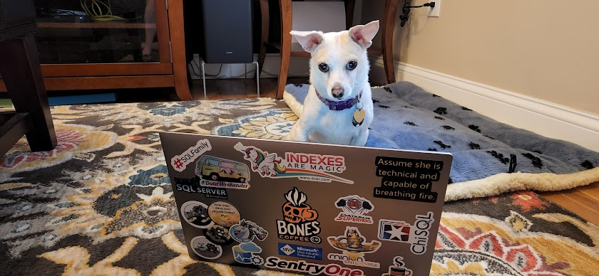
Who Am I?
I’m the alto section leader in my choir.
I go to bluegrass jams regularly.
I’ve been learning guitar and now mandolin.
I am a bit of a musical theater geek.
My husband and I take pictures of our dog doing geeky things.

Slide 5
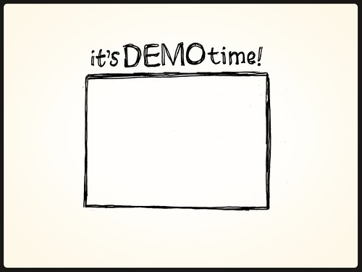
Agenda
Get to know the SQL Notebook interface
Use Cases
Troubleshooting Cheat Sheet
Development Testing Procedures
Interaction with SSMS
Notes:
If there is time, invoke-sqlnotebooks moduleThis Photo by Unknown Author is licensed under CC BY-NC-ND

Slide 6
Before we continue - Did we check in our code???

Slide 7
Advantages of SQL Notebooks
Documentation
Ability to save results with the queries
Can use the same tool for multiple kernels
Can be run by PowerShell and SQL Agent Jobs
Monthly Updates to Azure Data Studio
The Experience team is paying attention

Slide 8
Limitations of SQL Notebooks
1 Kernel Per SQL Notebook – Either SQL or PowerShell or Python, etc.
Exception – Polyglot Notebooks
Polyglot is technically still in Preview
No Execution Plan for the query built in for Notebooks
Adjustment to a new tool

Slide 9
References
Azure Data Studio Git Hub
Notebooks that show features from SQL 2019
List of nuget package versions for Microsoft.DotNet.Interactive.SQLServer
.NET Conf 2022 - The Power of Polyglot Notebooks (YouTube)
Notes:
Deprecating these but keeping around just in case:
https://github.com/microsoft/azuredatastudio/tree/main/samples
Bringing .NET Interactive to Azure Data Studio: https://www.youtube.com/watch?v=938jBJ-tK3c

Slide 10
References (cont’d)
Microsoft DevBlogs about Polyglot notebooks (with demos)
https://devblogs.microsoft.com/dotnet/dotnet-interactive-notebooks-is-now-polyglot-notebooks/
https://devblogs.microsoft.com/dotnet/net-interactive-preview-3-vs-code-insiders-and-polyglot-notebooks/
https://devblogs.microsoft.com/dotnet/net-interactive-with-sql-net-notebooks-in-visual-studio-code/

Slide 11
References – Community References
Glenn Berry - Diagnostic Queries in Notebooks
Aaron Nelson - Automating SQL Notebooks
Rob Sewell - Module for creating Notebooks with PowerShell

Slide 12
More Resources
SQLCommunity Slack: #azure-data-studio
Twitter: @AzureDataStudio

Slide 13



Any Other Questions?
Email: dgmelkin@gmail.com
Twitter: @dgmelkin
Mastodon: dataplatform.social/@dgmelkin
Blog: DebtheDBA.wordpress.com
Github: DebtheDBA - PracticalStarterGuideSQLNotebooks
DB Scripts: https://tinyurl.com/y22ys3oc

Slide 14

Thanks for Coming!!!

